Slide 1
BACHELOR DEGREE IN HR PLANNING AND MANAGEMENT III
MODULE NAME: PERFORMANCE MANAGEMENT AND APPRAISAL
MODULE CODE: HRU08101

Slide 2
TOPIC 02: PERFORMANCE APPRAISAL
The Concept of Performance Appraisal
The Deference between Performance Management and Appraisal
Objectives of Performance Appraisal
The Uses or Importance of Performance Appraisal
Performance Standards
The Elements/Process or Stages of Performance Appraisal

Slide 3
PERFOMANCE APPRAISAL
-Performance Appraisal [P/A]-is the process of assessing the performance and progress of an employee on a given job (Gupta, 2013).
-It is the process of analyzing and recording information about the worth of an employee.
CHARACTERISTICS OF P/A PROCESS
It consists of a series of steps.
It examines employee’s strengths and weakness in terms of job.
It is an objective study.
It is a continuous/ongoing process, The evaluations are arranged periodically.

Slide 4
OBJECTIVES OF APPRAISING PERFORMANCE;
To get information necessary for making objective and correct decisions on employees.
To provide flack/publicity to employees so that they can know where to stand. This can improve their job performance.
To provide data for salary recommendations of employees.
To identify the strengths and weakness of individual employees.
To provide counseling, planning and motivation to subordinate,
To develop positive relations between superiors and subordinates. This reduces conflicts.
To test the effectiveness of recruitment, placement and orientation.
To provide the room for employees and supervisors to discuss performance standards.
Through P/A employees get to know their weakness and take steps to overcome them.

Slide 5
THE USES OR IMPORTANCE OF PERFORMANCE APPRAISAL
It provides useful information in personnel/human resource decisions, for example deciding on pay rates, promotions, demotions, transfer or termination
It helps to test effectiveness of recruitment and orientation system of the organization, when recruitment and orientation systems are less effective the performance of employees can be low and is revealed by performance appraisal
It helps in analysing training and development needs, through performance appraisal the deficiencies/gaps in knowledge and skills of employees are well revealed
It helps in improving performance of employees, performance appraisal provides appropriate feedback on the performance of employee and counselling can be done to improve performance level of employees

Slide 6
5. It is used in human resource planning, through performance appraisal it is easy to know the type and number of workforces needed in future, also succession and career plans are possible under the help of performance appraisal
6. It helps to motivate employees; this is by building competitive spirit among employees
7. It helps to build confidence among employees, this is because appraisal records protect employees. For example, they help in promotion and disciplinary actions
8. It helps in job design, performance appraisal helps to know the effectiveness of job design and helps to make improvement in job design, this is because poor performance can be a result of bad job design.
9. It helps to know external challenges of employees, these external challenges can be family, financial, health and other personal matters

Slide 7
PERFORMANCE STANDARDS…
Performance standards for a job means the conditions expected to exist when the job is done in an acceptable manner (Kirkpatrick, 2006). The standards are usually moderate and objectives can even be higher than standards to allow most of employees to perform above the standards given.
CHARACTERISTICS OF PERFORMANCE STANDARDS
With regard to Kirkpatrick, (2006) the effective performance standards have the following characteristics/features:
1. They are based on the job and not the person in the job; standards of performance should be established for the job itself regardless of who occupies the job. There should be one set of standards for the job, not one set for every person doing that particular job. Standards of performance are different from objectives. Objectives should be set for an individual, rather than for a job.

Slide 8
CHARACTERISTICS OF PERFORMANCE STANDARDS…..
2. They are achievable; this means that practically all employees on the job should be able to reach the set performance standards. Usually, many employees should reach 125 percent of the standards.
3. They are understood, Performance standards should be clear to manager and employees
4. They are agreed on; both manager and employee should agree that the standards are fair. This is very important in motivating an employee.
5. They are specific and measurable; performance standards must be stated in numbers, percentages or some other form that can be quantifiably measured. And if they cannot be quantified, they should be very specific.

Slide 9
……CHARACTERISTICS OF PERFORMANCE STANDARDS
6. They are time oriented; it should be clear whether the standards are to be accomplished by a specific date or whether are ongoing.
7. They are written; both manager and employee should have a written copy of the standards that are agreed on. In this way, they won’t have to rely on memory, and the standard can be a constant reminder to both parties.
8. They are subject to change; performance standards should be periodically evaluated and changed if necessary. The need to change may be new methods, new equipment, new materials, or changes in other significant job factors. But they should not be changed because a performer is not meeting them

Slide 10
STEPS/PROCESS OF P/A………..
Setting performance standards; this is the criteria to be used for appraising the performance of employees. This is specified by job analysis which reveals the content of job.
Communicating the standards; in this case performance standards is explained to employees so that they know what is expected from them. In this step there can be reaction from employees to the standards, and then it can be revised or modified with respect to their evaluations.
Measuring the actual performance; it involves checking the actual performance and factors influencing such performance. Also, information about results/achievements is collected through observation, written reports or face to face meetings

Slide 11
4. Comparing actual performance with performance standards; this shows positive or negative deviation from the standards, if the actual performance exceeds the performance standards the positive deviation exists and the vice versa is true.
5. Discussing results; in this case reasons for deviations are discussed and analyzed while pointing out weaknesses and strengths on the part of employee or on a part of appraisal system itself.
6. Taking corrective actions; at this point, steps to improve performance are identified and introduced; example training, coaching, counseling and others, this is done through mutual discussions with the employees.

Slide 12
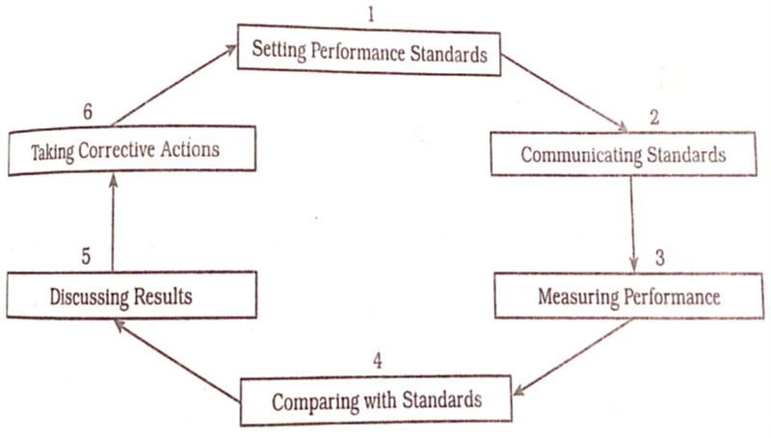
Figure 2.1 The Performance Appraisal Process

Slide 13
Why performance appraisal fails?
Bad Managers perception on performance appraisal, Most of managers perceive that there is less benefits from the time and energy spent in the process of P/A
Managers dislike face to face confrontation/conversation with employees
Lack of skills among HR managers to conduct P/A
The judgmental process of P/A is in conflict with the helping role of developing employees

Slide 14
REFERENCES
Armstrong, M. (2009). Handbook of Human Resource Management Practice, 11th Edition,. New Delhi: Koganpage.
Bernadin, J. (2007). Human Resource Management: An Experiential Approach, 4th Edition,. New Delhi: Tata McGraw-Hill Publishing Company Limited.
Dessler, G. (2008). Human Resources Management, Eleventh Edition. Upper Saddle River, New Jersey: Pearson Prentice Hall.
Dessler, G., Cole, N., & Virginia, L. (1999). Human Resources Management in Canada, Canadian Seventh Edidition. Upper Saddle River, New Jersey: Prentice- Hall, Inc.
Gupta, C. (2013). Human Resource Management, Text and Cases. New Delhi: Sultan Chand & Sons Educational Publishers.
Kirkpatrick, D. (2006). Improving Employees Performance through Appraisal and Coaching, 2nd Edition. New York: AMACOM.

Slide 15
